Slide 1
Image Classification
With Linear SVM
Thanet Sirichanyaphong 5730251121
Nitichai Tiyaamornwong 5730303121

Slide 2
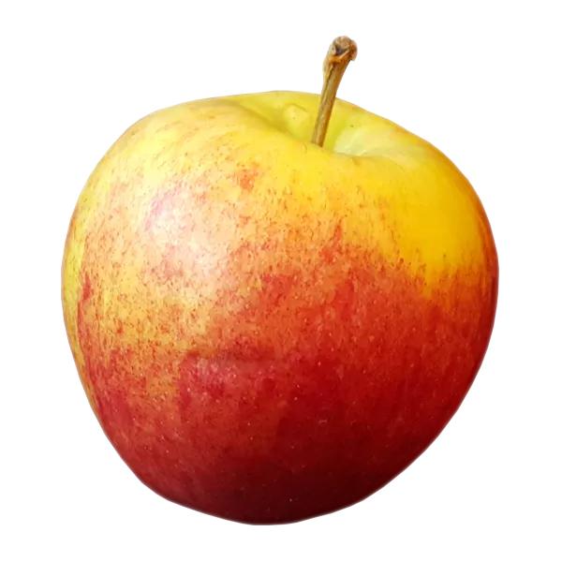


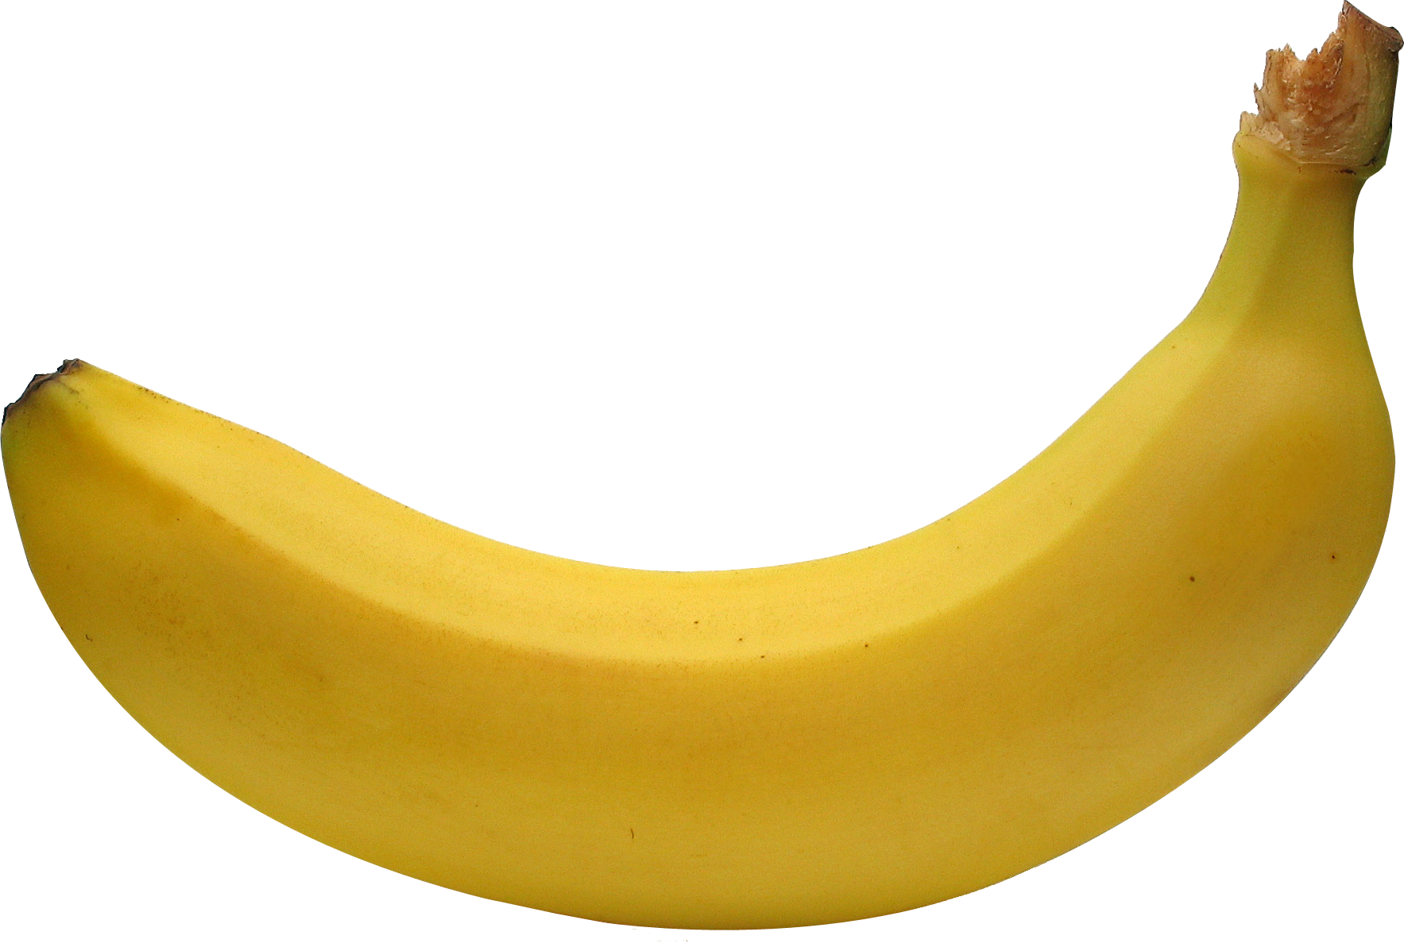
Problem : Apple or Banana ?
OR
We would like to create a model which can determine which image is apple or banana.

Slide 3
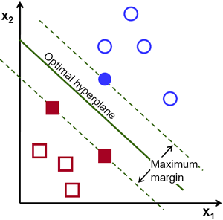
Model For Classification : SVM (linear)
SVM stands for support Vector machines. It is basically used in binary classification problems.
The SVM approach helps in ascertaining the decision boundary for a given data set. This decision boundary is then used to classify the untagged data.

Slide 4
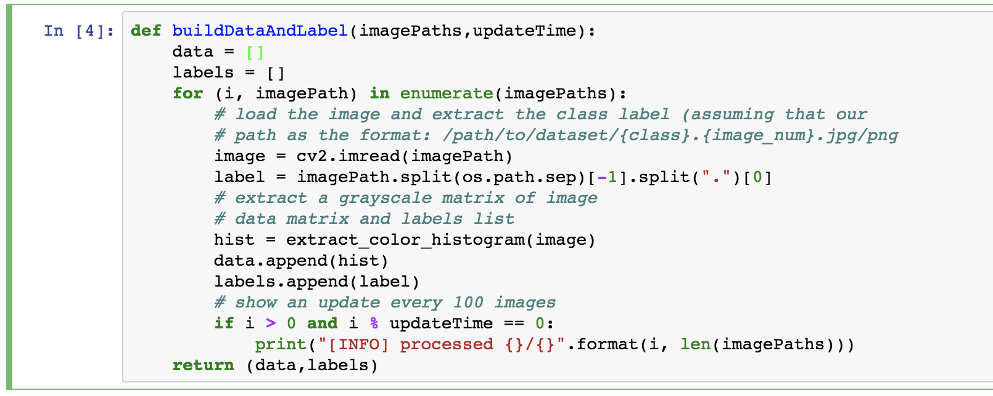
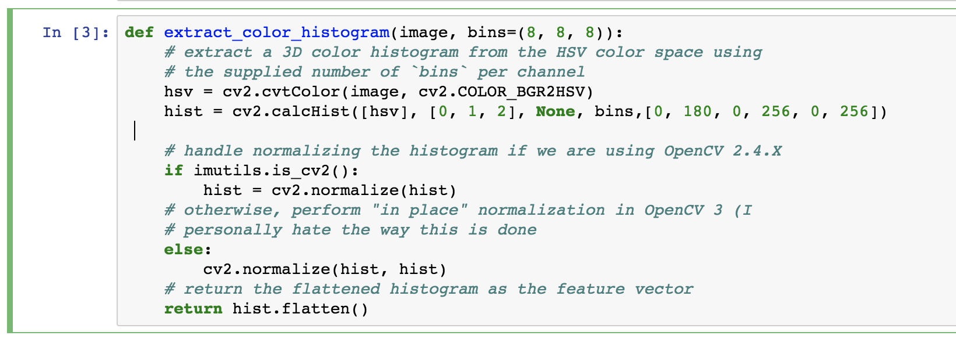
Methodology
Collecting Image Data from google searching and do preprocessing all images
1.1 Loop through all images in dataset folders and call the extract_color_histogram for each image.
1.2 Preprocess each images by converting it to the HSV color space, and then computes a 3D color histogram. After computing the color histogram using the cv2.calcHist function, the histogram is normalized and then returned to the calling function.

Slide 5
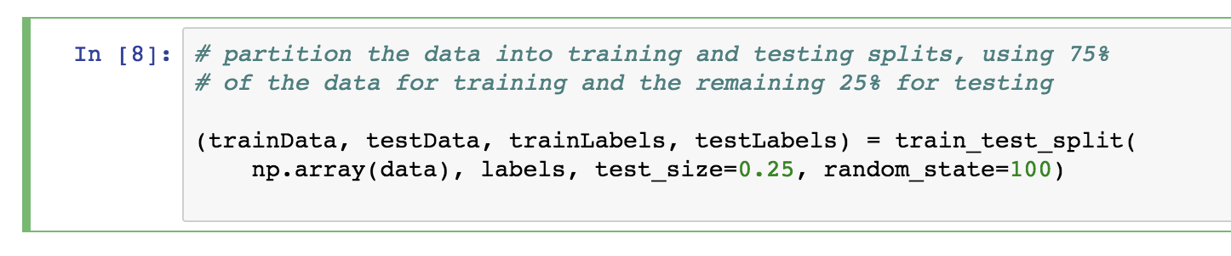
Methodology
2. Split train test data for training
Parameter for train_test_split function
Test_size = 0.25 : to create 75% train data and 25% test data of dataset
Random_state = 100 : seed number

Slide 6
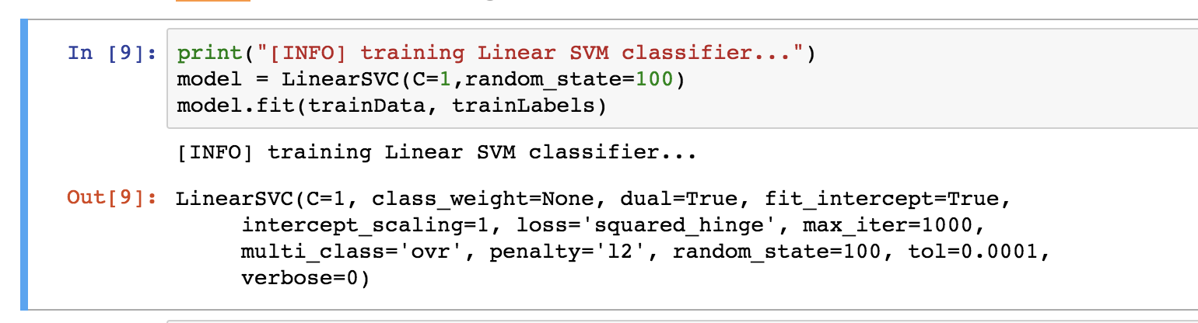
Methodology
3. Split train test data for training
Parameter for creating Linear SVM classifier
C = 1 : how much to penalize misclassified points
Random_state = 100 : seed number

Slide 7
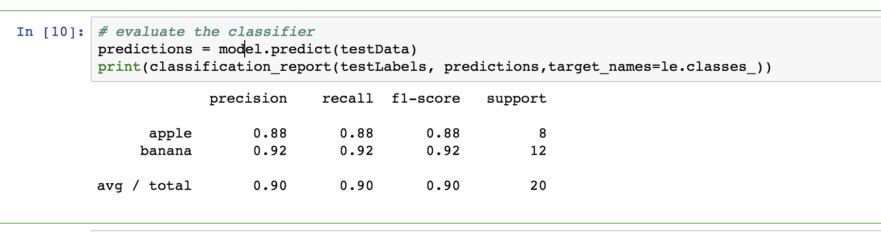
Result
By evaluating classifier

Slide 8
Thank You
https://github.com/aiThanet/AppleBananaClassifier

